Slide 1
introducing NodeJS
How to create Hello, World NodeJS App
Notes:
This presentation demonstrates the new capabilities of PowerPoint and it is best viewed in Slide Show. These slides are designed to give you great ideas for the presentations you’ll create in PowerPoint 2010!
For more sample templates, click the File tab, and then on the New tab, click Sample Templates.

Slide 2
xBIT: cross-Boundary Interests Team
1
2
3
Join be Intrigued
Learn by Building
Improve via Sharing
Reinvent the Wheel – In a Different Way

Slide 3
Topics
History
Basics
DIY

Slide 4
1
History

Slide 5
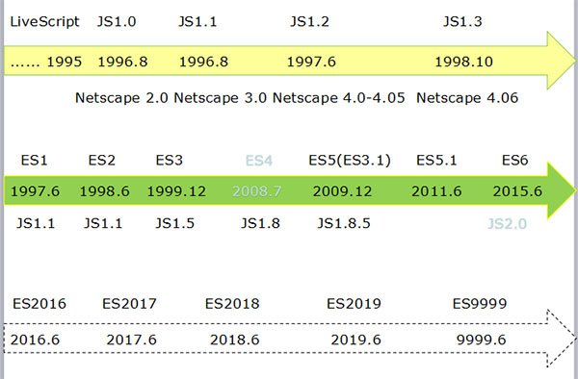
Evolving of Javascript & EMACScript
Brendan Eich花了10天时间设计了javascript，借鉴了c的语法，函数借鉴了scheme，原型借鉴了self。
原名：LiveScript，为了搭Java顺风车，更名为JavaScript
ES(ECMAScript)和JS(JavaScript)的区别: JS = ES + VM; ES指代规范，JS指代具体的实现。

Slide 6
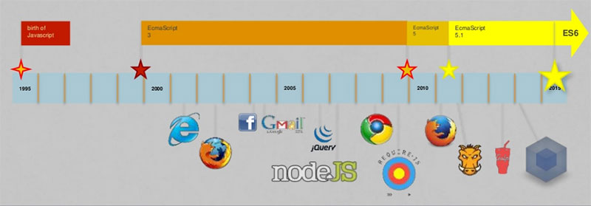
Milestones of JS/ES
1995 – Birth of JS
Start of Internet
2000 – Standardization
First Bubble
2010 – ES5
Cloud Computing
2016 – ES6
…

Slide 7

History of NodeJS
2009 – Created by Ryan Dahl
2010
Express: A NodeJS development Framework
Socket.io released
2011
NPM 1.0 released
Adopted by LinkedIn & Uber
2013
MEAN
More adopters
KOA – express relacement
2014
Integrated with IO.JS (Event I/O for V8 engine)
2015 and forthward
ES5 + ES6 …
Now:
https://nodejs.org/en/

Slide 8
Why Javascript & NodeJS?
Interests!
We cannot miss a language with such a high rating!
Top 1 language on GITHUB search
No. 1 of The RedMonk Programming Language Rankings (Combined results from Github, Google & StackOverflow)
Rank 5 of PYPL: PopularitY of Programming Language (Search by tutorial on Google)
For Java Programmers, it has totally different ways of thinking!
You can always borrow from each other
NodeJS cracks problems in a different way
Clustering
Workers

Slide 9
2
Basics

Slide 10
Installing NodeJS
Node JS is
A Javascript VM (Runtime)built on Chrome’s V8 Javascript Engine
an open-source, cross-platform runtime environment for developing server-side Web applications
NodeJS is NOT
A language
A Javascript Framework
Download NodeJS from https://nodejs.org/en/
Current version is v6.2.0

Slide 11
First Impression
Install NodeJS
Like many other script engines, NodeJS can be executed interactively
Execute node in command line
^D to quit shell
Or you can execute an already written script file
Execute node helloworld.js

Slide 12
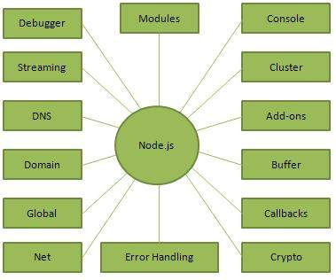
More for seriousness
You can not write everything from scrach
Java programs would refer to 3rd JARs
Learn how to borrow from others!
NPM at rescue
Coming with NodeJS installation sudo npm install npm -g
Package management tool for server side logics
Local package specific to application
DEV dependency
Runtime dependency
Global package
Package in package.json
Not necessarily written purely in JS
Manually create or npm init

Slide 13
Even more for completeness
Never forgot Javascript is born for frontend stuff
Browser’s JS files?
CSS files?
Bower is the standard
Modules saved in bower.json
npm install -g bower
Before using the bower, initialize you app first
Create bower.json in root folder
Or simply “bower init”
bower install jquery

Slide 14
Put all together!
Create Hello application with fancy stuff
angularJS
bootstrap
Topic of Next Session
Improve the Hello application to add more functions
Save with mongoose (MongoDB)
User management with passport?
Homework~

Slide 15
3
DIY: Wet Hands

Slide 16
Step 1. Preparation
Create application folder
mkdir <your app root>
cd <your app root>
bower init
Install dependencies
Backend dependencies
sudo npm install express
Frontend dependencies
bower install angular jquery bootstrap
Create app.js
http://expressjs.com/en/starter/hello-world.html
node app.js
http://localhost:8000/

Slide 17
Step 2. Add HTML Stuff
Create views folder
mkdir <your app root>/views
By default, the EJS (view engine) will look for views under <approot>/views
Create your first view
hello.ejs
Update app.js
Set view engine
Render the view when accessing our web app
https://www.codementor.io/nodejs/tutorial/node-with-express-and-ejs
See the output
node app.js
http://localhost:8000/

Slide 18
Step 3. AngularJS?
AngularJS can make the views in a more straight way
Instead of using <h1>Hello, world</h1> …
How about <say-hello></say-hello>?
The magic is hidden in AngularJS
Let’s get our hands wet!
sudo npm install path
Update app.js to expose bower_components to browser
Update hello.ejs to use angular
Create main.js for the new directive we are using
Get the app rolling!

Slide 19
Bootstrap!
Bootstrap is a style library provided by twitter
http://getbootstrap.com/
Let’s get our page looks a little better
Update hello.ejs to include bootstrap css
Update hello.ejs to add few DIVs to style our stuff
Update our angular directive to use bootstrap class
Done!

Slide 20

But wait… There’s LOTS More!
?
View your slides from anywhere!

Slide 21
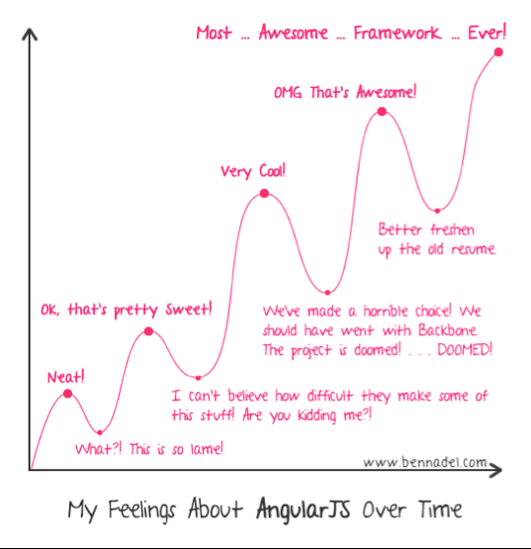
Be Prepared & Have Fun

Slide 22
Suggestions & Advices
Try combining all you have known
Think impossible and then prove or deny
Don’t over-estimate yourself
You are not ALONE (on top of the world)
What you met / thought / solved others may have already done
Don’t under-estimate yourself
You are (possibly much) better than lots of others
Learn & Self-improve are important
Google / Stackoverflow / Github …

Slide 23
Practice?
Integrate Mongoose (MongoDB)?
User Management?

